Slide 1
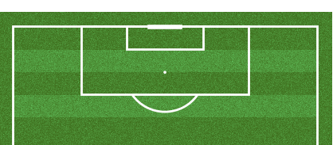
Defender location
Shot location

